Slide 1

Cpsc1517
OOP Review – Day 0

Slide 2
Lesson Objective
By the end of this lesson, learners should be able to:
  Define Class Library
  Components of Class ( Principle of Encapsulation)
    Attributes ( Data members )
    Behaviour ( Methods )
    Properties (Auto-Implemented vs Fully-Implemented Properties )
    Constructors (
  Access Modifiers / Specifiers
    public/private/protected/internal
  Clean code approach using the #region keyword
  Use Exceptions

Slide 3
Exploring the Topic

Slide 4
Class Nameing Conventions
Use Pascal Case (TheFirstLetterOfEveryWordIsCapitalized)
Generally short and descriptive
Generally singular

Slide 5
Class Terminology
Attributes aka Data Members (_Name)
Methods aka Behaviours (accessor return_type Name(parameters))
Properties (Name)
Constructors (Same as class name, various types)

Slide 6
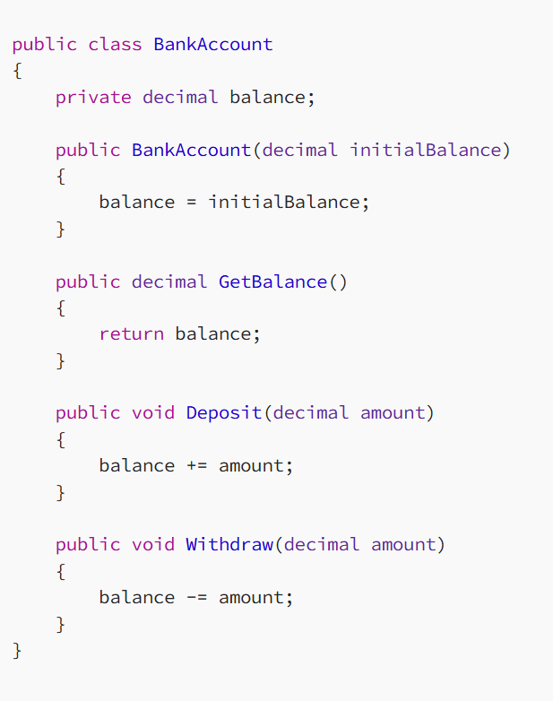
Encapsulation
A fundamental concept in OOP
It refers to the bundling of data and related operations into a single unit, or object.
In C#, encapsulation is achieved through the use of classes and access modifiers such as public, private, and protected.
The meaning of Encapsulation, is to make sure that "sensitive" data is hidden from users. To achieve this, you must:
  declare fields/variables as private
  provide public get and set methods, through properties, to access and update the value of a private field
C# Properties (Get and Set)
Notes:
In this example, the BankAccount class encapsulates data (the balance field) and related operations (the Deposit and Withdraw methods). The balance field is marked as private, meaning it can only be accessed within the BankAccount class. This ensures that the balance can only be modified through the Deposit and Withdraw methods, which can enforce any necessary business logic or validation.
The GetBalance method, on the other hand, is marked as public, meaning it can be called from outside the BankAccount class. This allows other code to retrieve the balance without being able to modify it directly.

Slide 7
Access Modifiers
Private – Can only be accessed in the same class/struct/etc.
Internal – Can only be accessed in the same assembly. We will use it during client server application.
Protected – Can only be accessed in the same or a derived class ( more discussion during inheritance).
Public – Can be accessed internally or externally.

Slide 9
Class Library
A class library file is a collection of classes and namespaces in C# without any entry point method like Main.
Once we create a class library file it can be used in the C# project and classes inside it can be used as required.
Defines one or more classes/methods/etc that we can reference in other projects
Can not be run independently

Slide 10
#region
A handy tool to make our code more readable
Allows us to easily collapse sections of our code (code folding)
Can be named
Ex:
  #region Constructors
  #endregion Constructors -Name is optional on endregion

Slide 11
PROPERTIES
A property is a member of a class that provides a flexible mechanism to read, write, or compute the value of a private field.
They are a type of class member that have accessors which define the operations to be performed on a field of the class.
The get accessor: returns the value of a private field
The set accessor: assigns a value to a private field

Slide 12
Auto-implement vs Fully-Implement
Auto-Implement:
  Not backed by an attribute
  Does not include validation or other code
Fully-Implement:
  Backed by a private attribute
  Can include validation or other code

Slide 13
Auto-implement vs Fully-Implement
Read-Only Properties: have a get accessor but no set accessor
Write-only properties: have a set accessor but no get accessor.
Properties with Private Setters: You can also create a property with a private set accessor, which can only be set within the class it is defined.

Slide 14
//Fully-Implemented
public string Name
{
get { return name; }
set { name = value; }
}
//Automatically-Implemented
public string Name { get; set; }

Slide 15
Exceptions
Two types of exceptions, expected and unexpected
Can (should) be handled inside of your code (try/catch block)
Generally occur when data of the wrong type is passed into your code
Will happen at run time, not compile time
Unhandled exceptions are known as bugs and will often crash your program

Slide 16
Exceptions cont.
As we’re writing our own Class Libraries, we’re responsible for throwing exceptions:
  throw new ArgumentException(“Exception Info”)
Exceptions should have a clear message and include the Property value that caused the exception
There are lots of exceptions. We’ll be starting with:
  ArgumentException – General catch all of something being wrong
  ArgumentOutOfRangeException – For when a value outside the expected range is passed
  ArgumentNullException – For required Properties

Slide 17
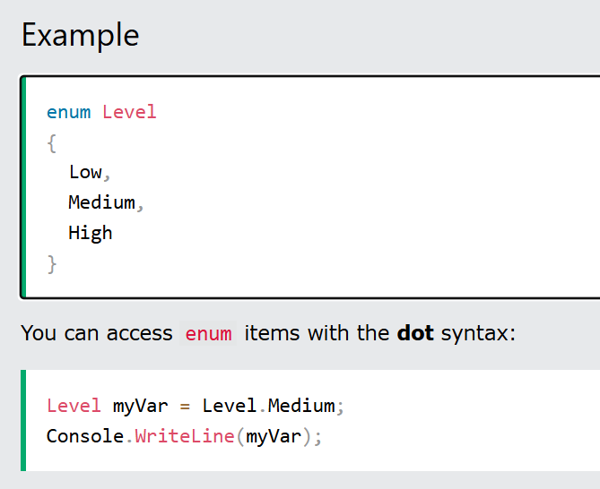
Enum
An enum is a special "class" that represents a group of constants (unchangeable/read-only variables).
To create an enum, use the enum keyword (instead of class or interface), and separate the enum items with a comma.
By default, the first item of an enum has the value 0. The second has the value 1, and so on.

Slide 18
Example

Slide 19
Lesson Objective Review
By the end of this lesson, learners should be able to:
  Define public/private/internal variables
  Use the #region keyword
  Define Attributes, Behaviours, Properties, and Constructors
  Use the principle of Encapsulation
  Define Auto-Implemented vs Fully-Implemented Properties
  Use Exceptions

Slide 20
Thank you!

Slide 21
References
Identifier names - rules and conventions - C# | Microsoft Learn

